Slide 1
The Periodic Table
Year 10 Pre ATAR Science

Slide 2
Review
Explain the difference between an atom and a molecule.
Explain the difference between an element and a compound.
Name the element with 30 protons.
Name the element with atomic number 83.
Write the symbol for the element with 3 electrons in the 4th electron shell.
An atom has 16 protons and 16 neutrons. What element is it and what is its mass number?

Slide 3
Learning Intention
The atomic structure and properties of elements are used to organise them in the Periodic Table
recognising that elements in the same group of the periodic table have similar properties
describing the structure of atoms in terms of electron shells
explaining how the electronic structure of an atom determines its position in the periodic table and its properties

Slide 4
Success Criteria
Identify groups and periods on the periodic table
Relate groups and periods to electrons in shells
Use the periodic table to write or draw electron configuration (arrangement of electrons)

Slide 5
Key words
group
period
valence
block
shell

Slide 6
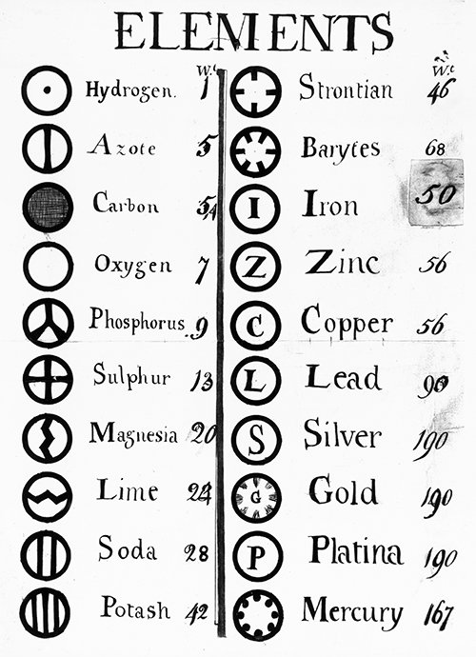
1808 Dalton’s List of Elements

Slide 7
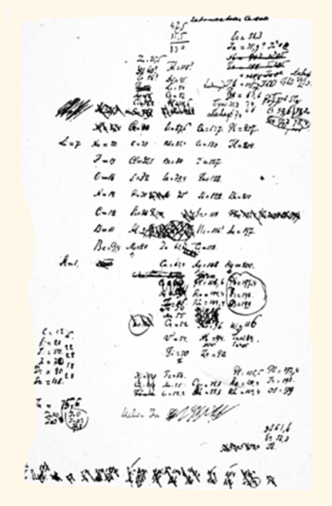

The Periodic Table
When Dmitri Mendeleev proposed his Periodic Table and Periodic Law in 1869, only 56 elements had been discovered.
His Periodic Table was one of many, but he was the first to predict the properties of as yet undiscovered elements.

Slide 8
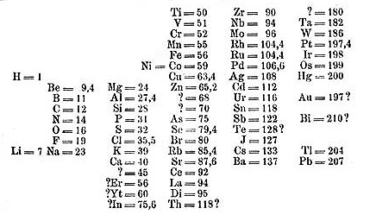
Initially elements were arranged in order by atomic weight (now atomic number), grouped by properties, which recurred periodically.

Slide 9
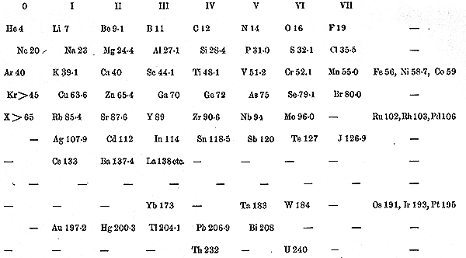
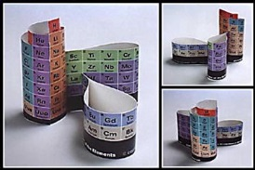
The Periodic Table has been improved and updated almost continuously , new elements were added, new groups were added as the noble gases were discovered and eventually new sections were added to make room for the discoveries made by the ‘atom smashers’ of the 1930s and beyond.

Slide 10
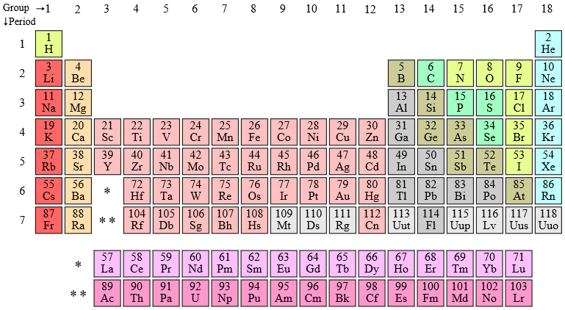
Groups
Vertical columns 1-18 represent chemical families, such as alkali metals, alkaline earth metals, halogens or noble gases.
Similar electron configurations in the valence (outside) shell.

Slide 11
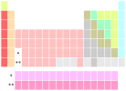


Slide 12
Periods
Horizontal rows 1-7
Elements in the same period (row) have the same number of electron shells.

Slide 13
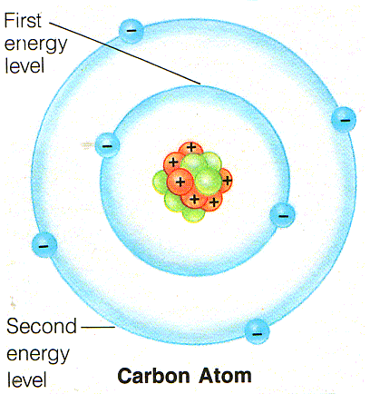

Slide 14
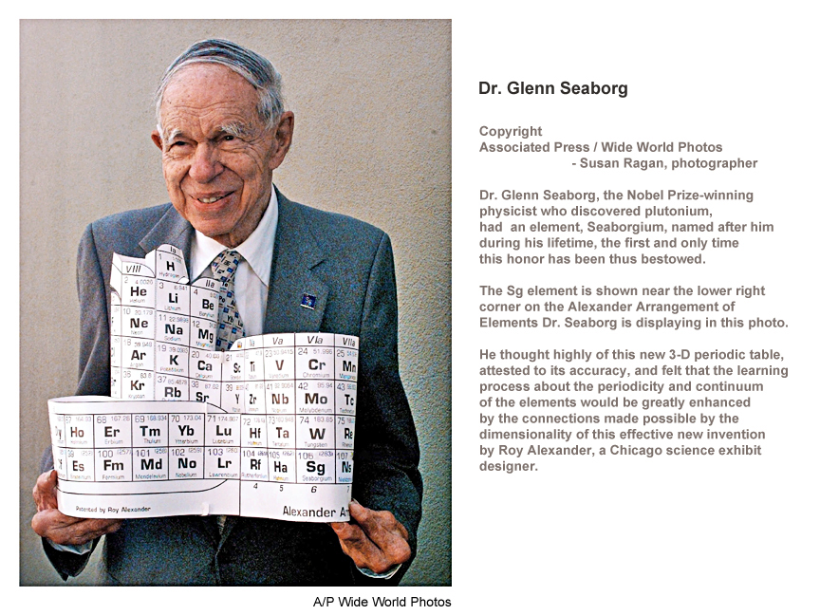
Periodic Table of the Elements -- Cylinder with Bulges (av8n.com)

Slide 15
Success Criteria
Identify groups and periods on the periodic table
Relate groups and periods to electrons in shells
Use the periodic table to write or draw electron configuration (arrangement of electrons)

